Slide 1
Web & Network Security: Web Vulnerabilities (Cont) CS-4440 - Introduction to Computer Security Spring 2022 Jun Xu Slides adapted from CSE 484/CSE M 584 by Ada Lerner at UW

Slide 2
Some Comments From Quiz 1
An incomplete list
Audio not clear in recordings (Fixed)
Whiteboard not clear in recordings (Hopefully Fixed)
More preparations for assignments (Trying to Fix)
Lectures are not clear (Trying to figure out the issues)

Slide 3







The Web Architecture We Use
Browser
POST / HTTP/1.0
Web
server
HTTP/1.1 200 OK
index.php
Database
server

Slide 4
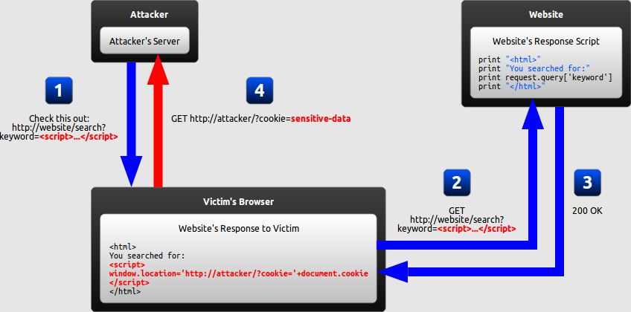
Recap: Reflected XSS

Slide 5
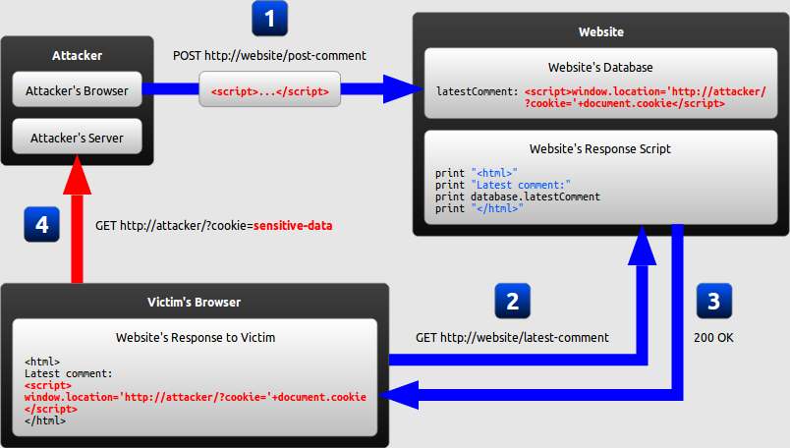
Recap: Stored XSS

Slide 6
XSS: Prevention
Do not include user supplied input in your output!
Output Encode all user supplied input
e.g., OWASP Java Encoder
Perform Allow List Input Validation on user input
Use an HTML Sanitizer for larger user supplied HTML chunks
e.g. ,OWASP Java HTML Sanitizer

Slide 7
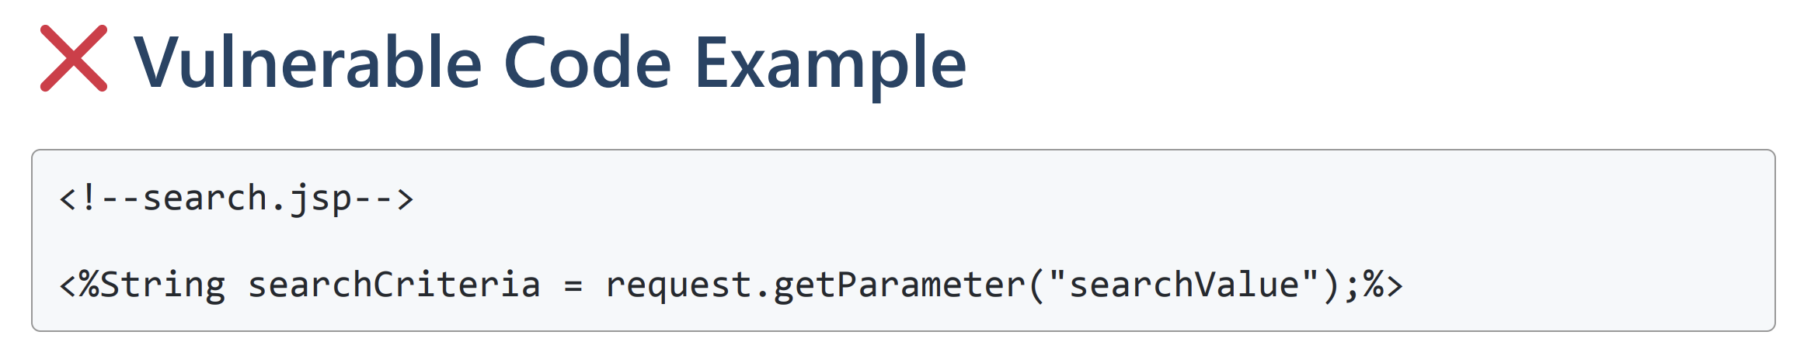
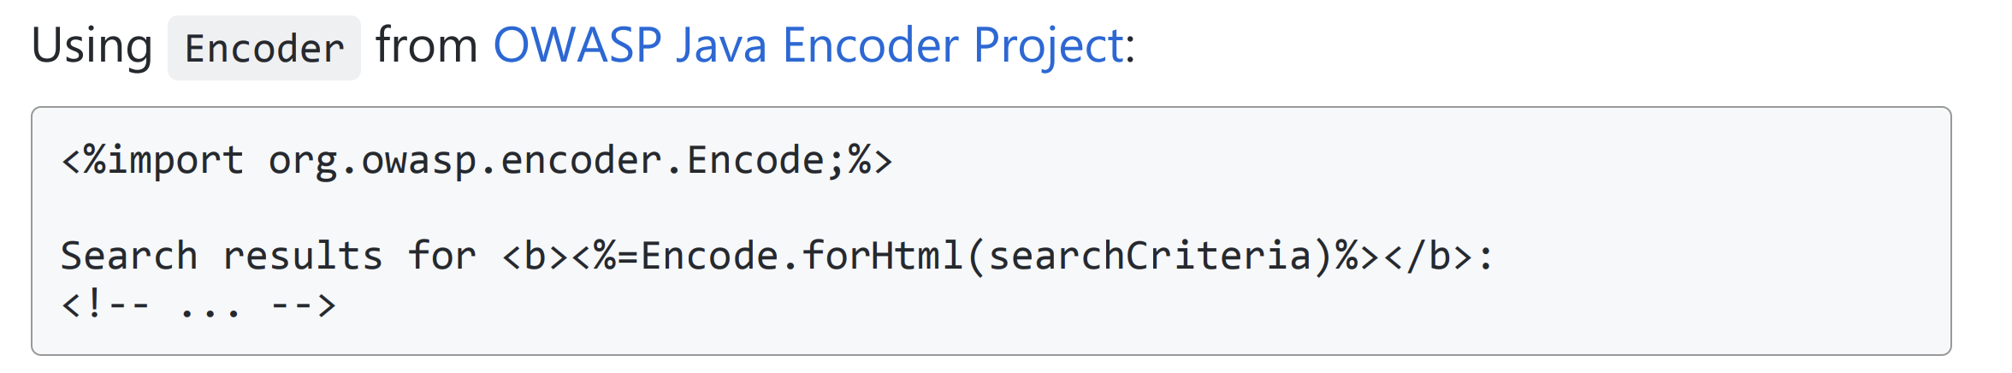
CSS Prevention: Encoding Contexts

Slide 8
CSS Prevention: Input Validation
Block List
"Allow what is not explicitly blocked!”
Example: Do not allow < , > , " , ; , ' and script in user input ( )
Can be bypassed by masking attack patterns
Must be updated for new attack patterns

Slide 9
CSS Prevention: Input Validation
Allow List
"Block what is not explicitly allowed!"
Example: Allow only a-z , A-Z and 0-9 in user input
Provide protection even against future vulnerabilities
Tend to get weaker over time when not carefully maintained
Can be quite effortsome to define for a whole application
= Positive Security Rule

Slide 10
Another Vulnerability Family
Cross-Site Request Forgery
(CSRF)

Slide 11
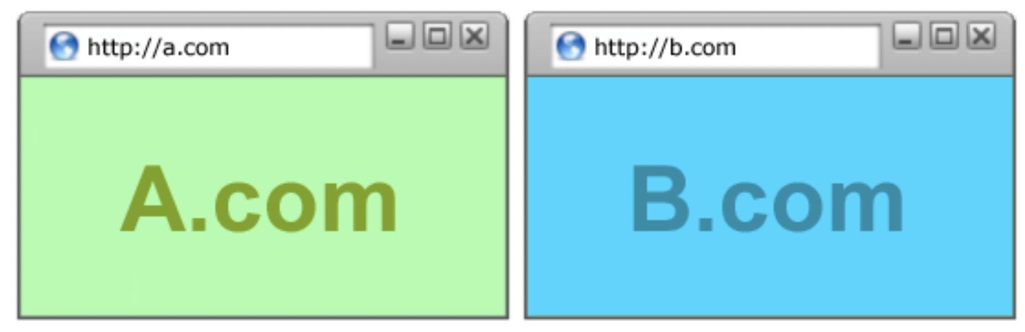
CSRF: Background
We must be allowed to visit two webpages at the same time, right?

Slide 12
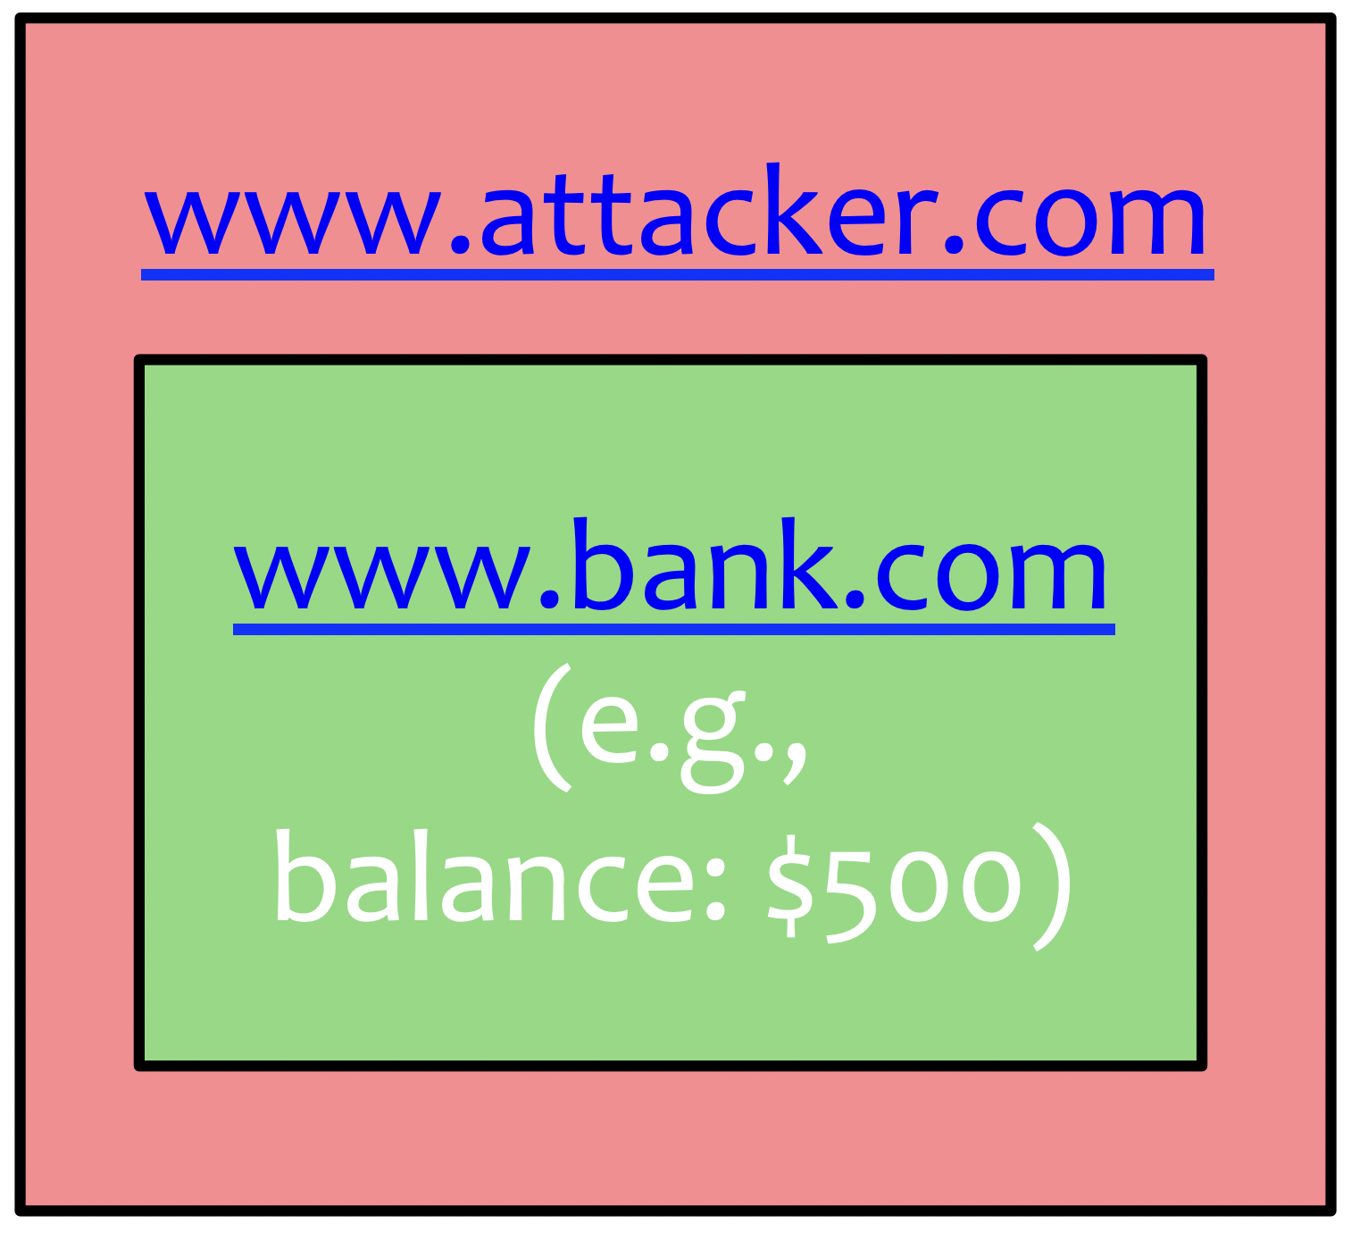
CSRF: Background
Can we allow this?
In this example, one webpage tries to access data on another webpage, assuming the two webpages are hosted on different websites

Slide 13
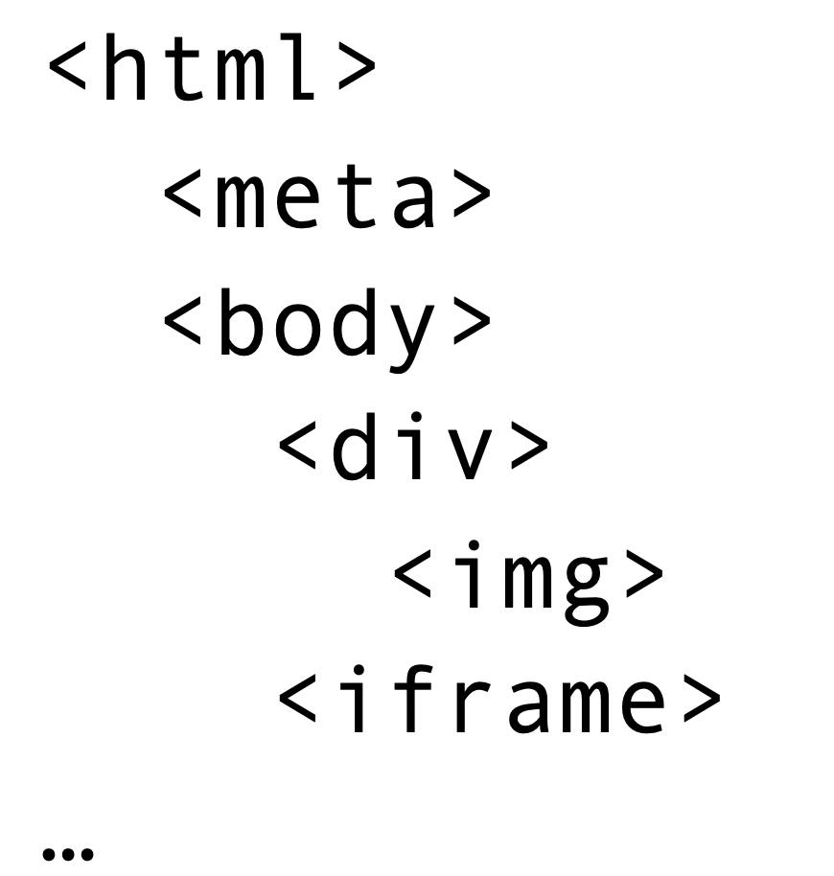
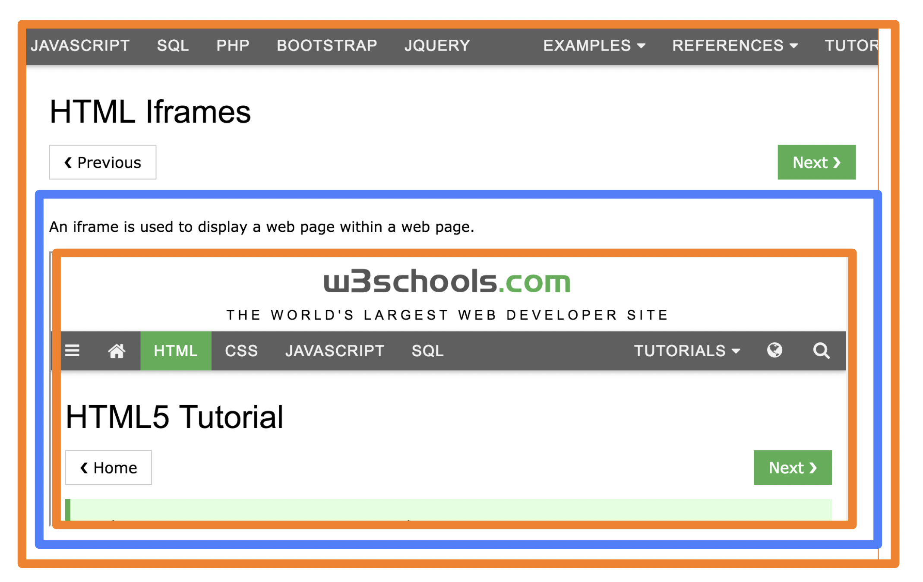
CSRF: Background: Iframe
HTML Iframe: used to display a web page within a web page.

Slide 14
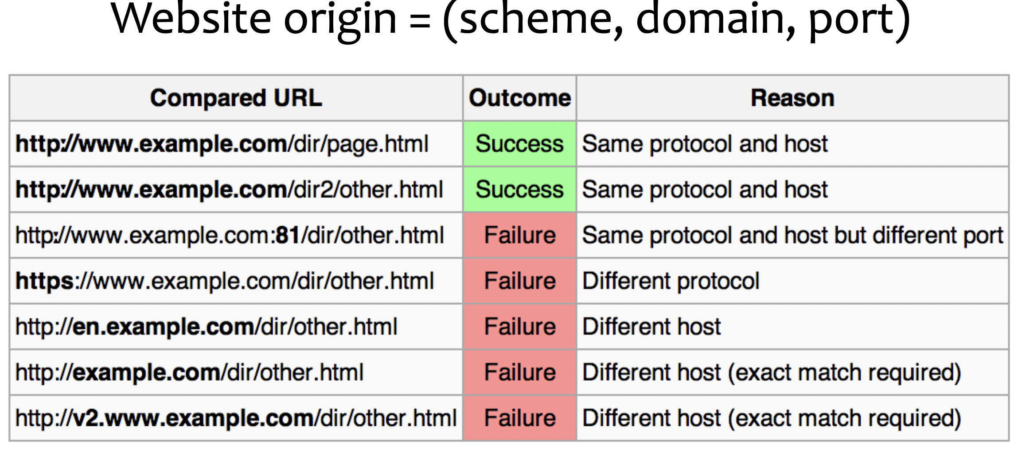
Same-Origin Policy: DOM
Only code from same origin can access HTML elements on another site (or in an iframe)

Slide 15
Cross-Origin Communication?
Can we allow this?
<!DOCTYPE html>
<html>
<head>
<title>Image Example</title>
</head>
<body>
<img src="https://i.etsystatic.com/30441432/r/il/f6e2a4/3533454704/il_1588xN.3533454704_mcuw.jpg">
</body>
</html>
What about: src="http://example.com/grades/submit?student=shadow&class=cse+591&grade=A%2B&submit=Submit"

Slide 16
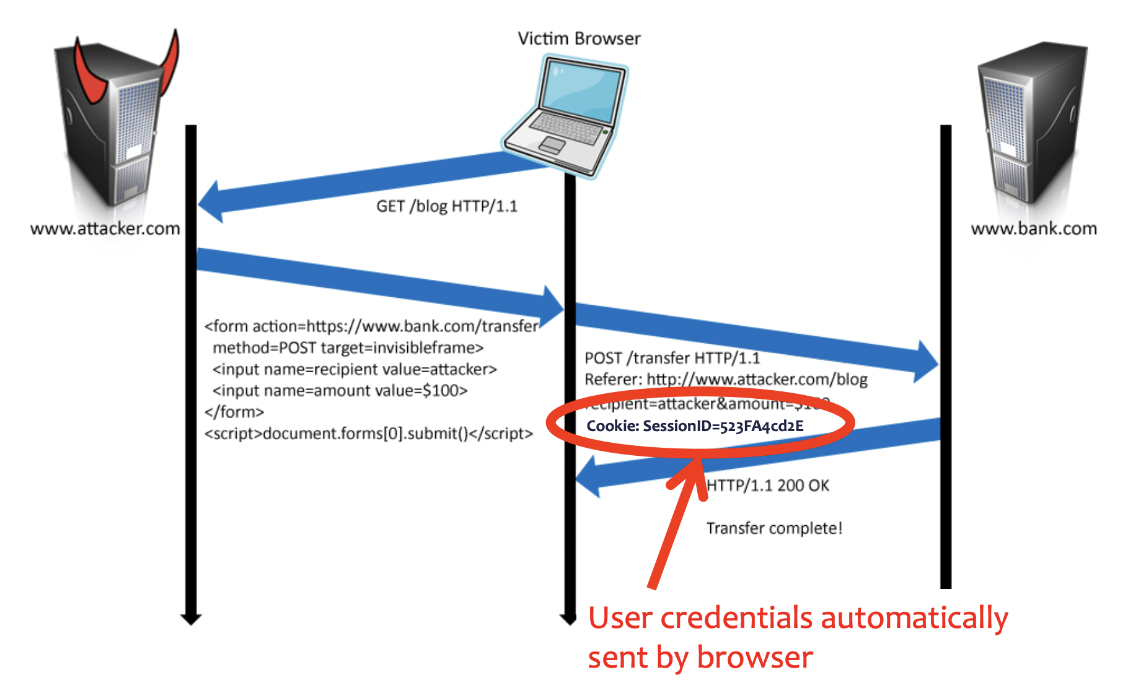
CSRF: An Example

Slide 17
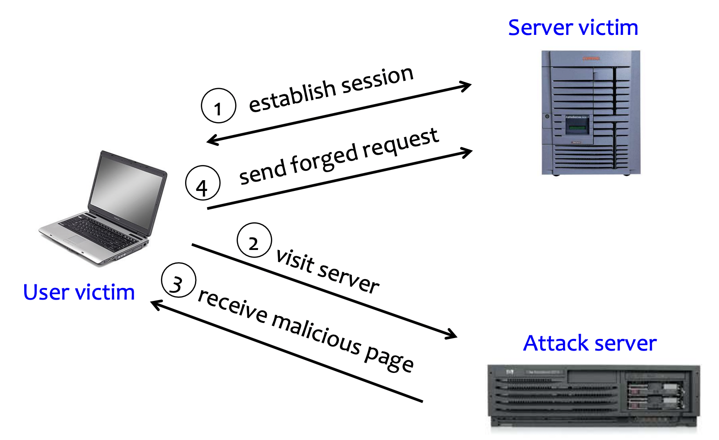
CSRF: A Summary

Slide 18
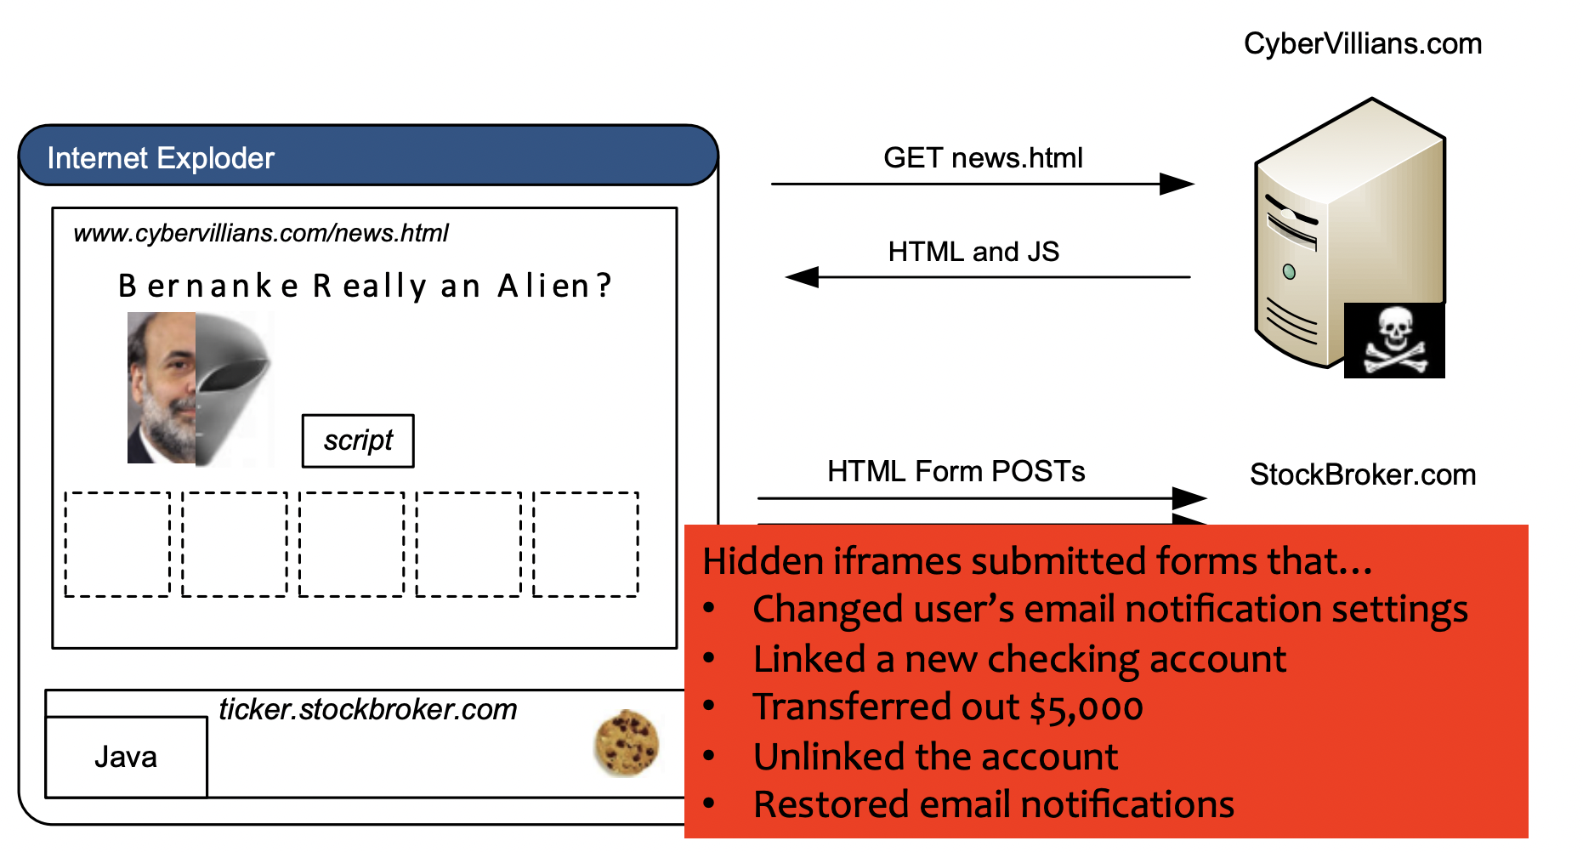
CSRF: A More Real Example [Alex Stamos]

Slide 19
CSRF: A broader view
Abuse of cross-site data export
– SOP does not control data export
– Malicious webpage can initiate requests from the user’s browser to an honest server
– Server thinks requests are part of the established session between the browser and the server (automatically sends cookies)

Slide 20
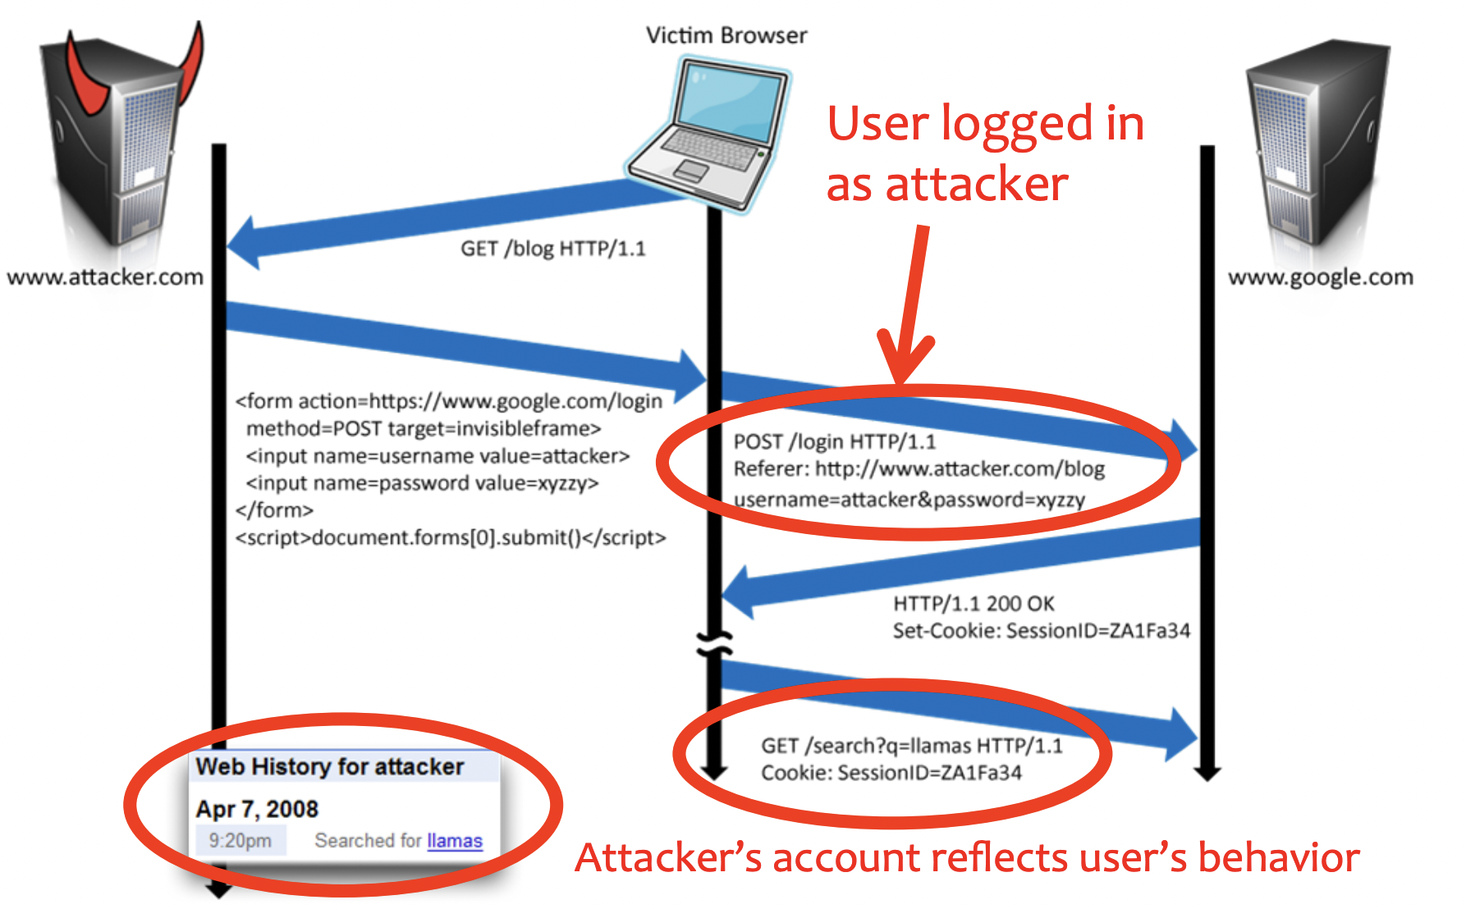
CSRF: Another Example: Deceived Log In

Slide 21
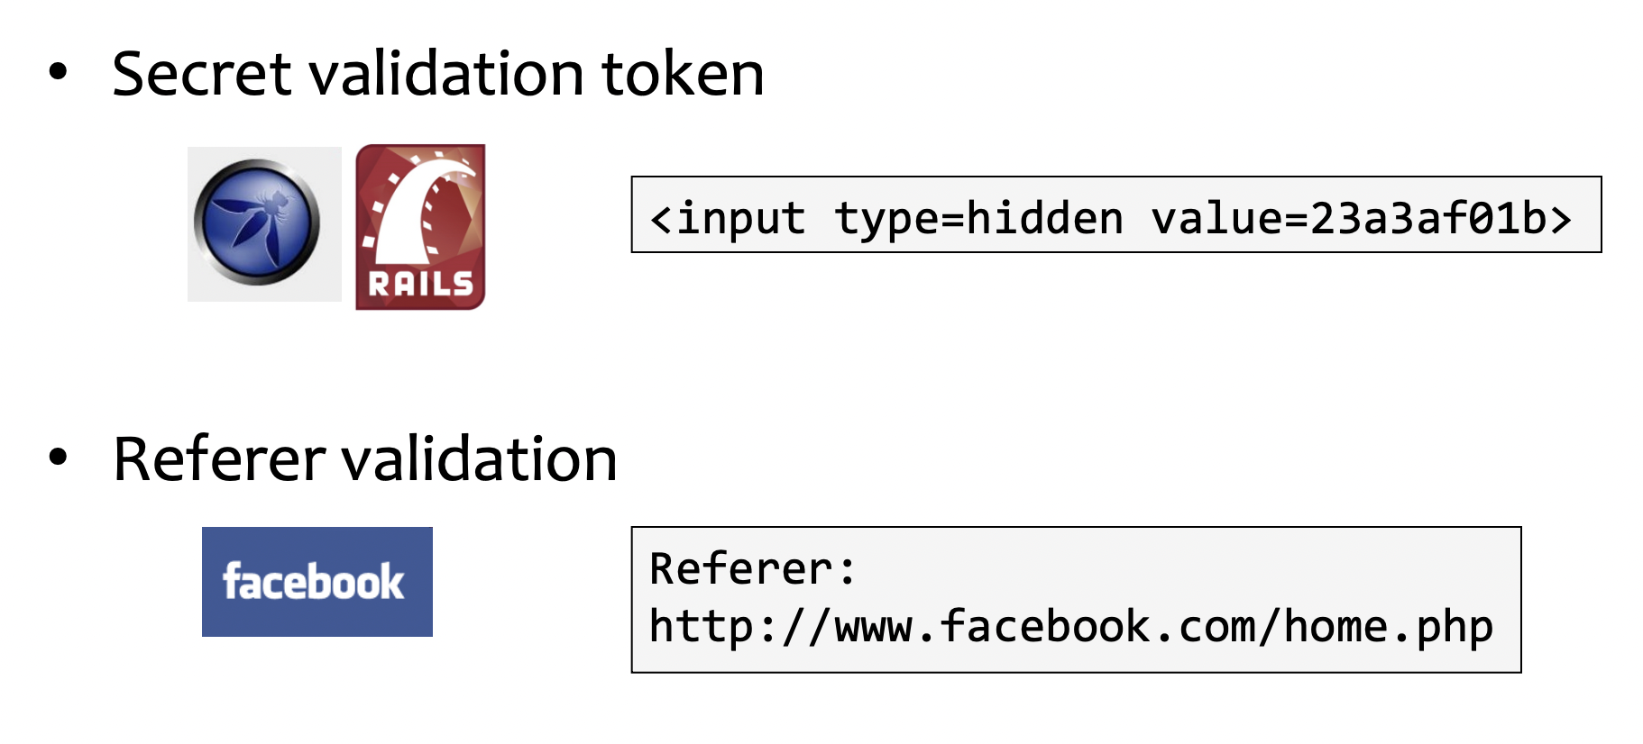
CSRF: Mitigations

Slide 22
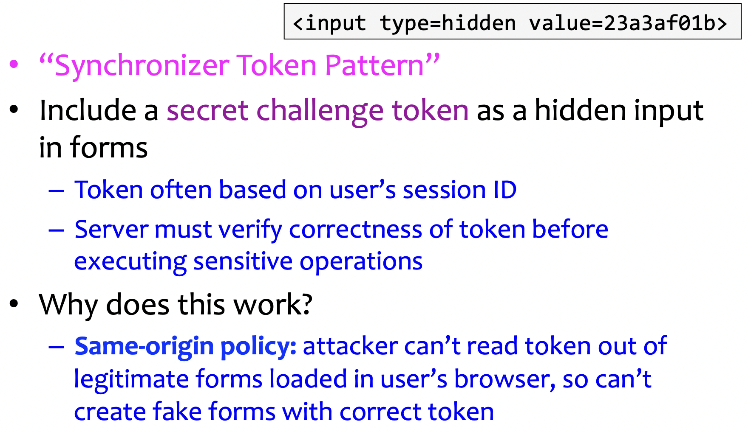
Add Secret Token to Forms

Slide 23
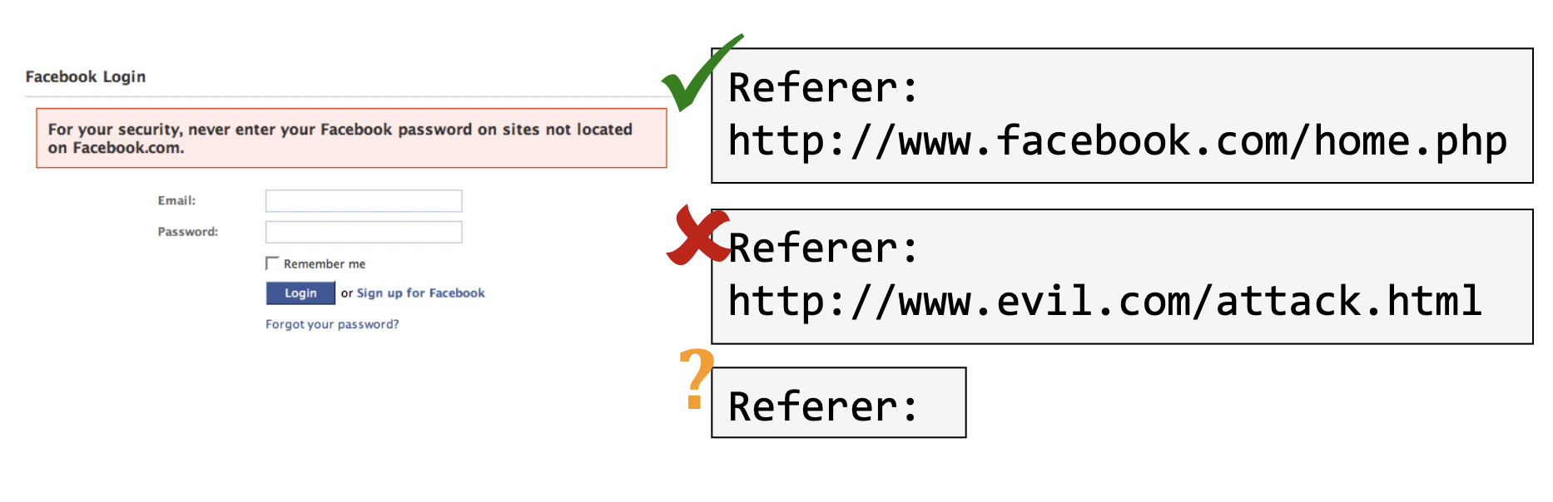
Referrer Validation

